Slide 1
Monitoring SQL Server at no costs
Danilo Dominici
ddominici@gmail.com

Slide 2
Sponsors

Slide 3





Who I am
Independent consultant, Trainer, Speaker, Author
Passionate about technology
Microsoft Certified Trainer since 2000
Microsoft Data Platform MVP since 2014

Slide 4
Monitoring SQL Server performance: benefits
Reduce performance-related incidents and outages
Better risk management
Lower infrastructure costs
Higher uptime

Slide 5
What to monitor?
CPU / Memory / Disk /Network usage
SQL Server performance counters
Specific KPIs

Slide 6
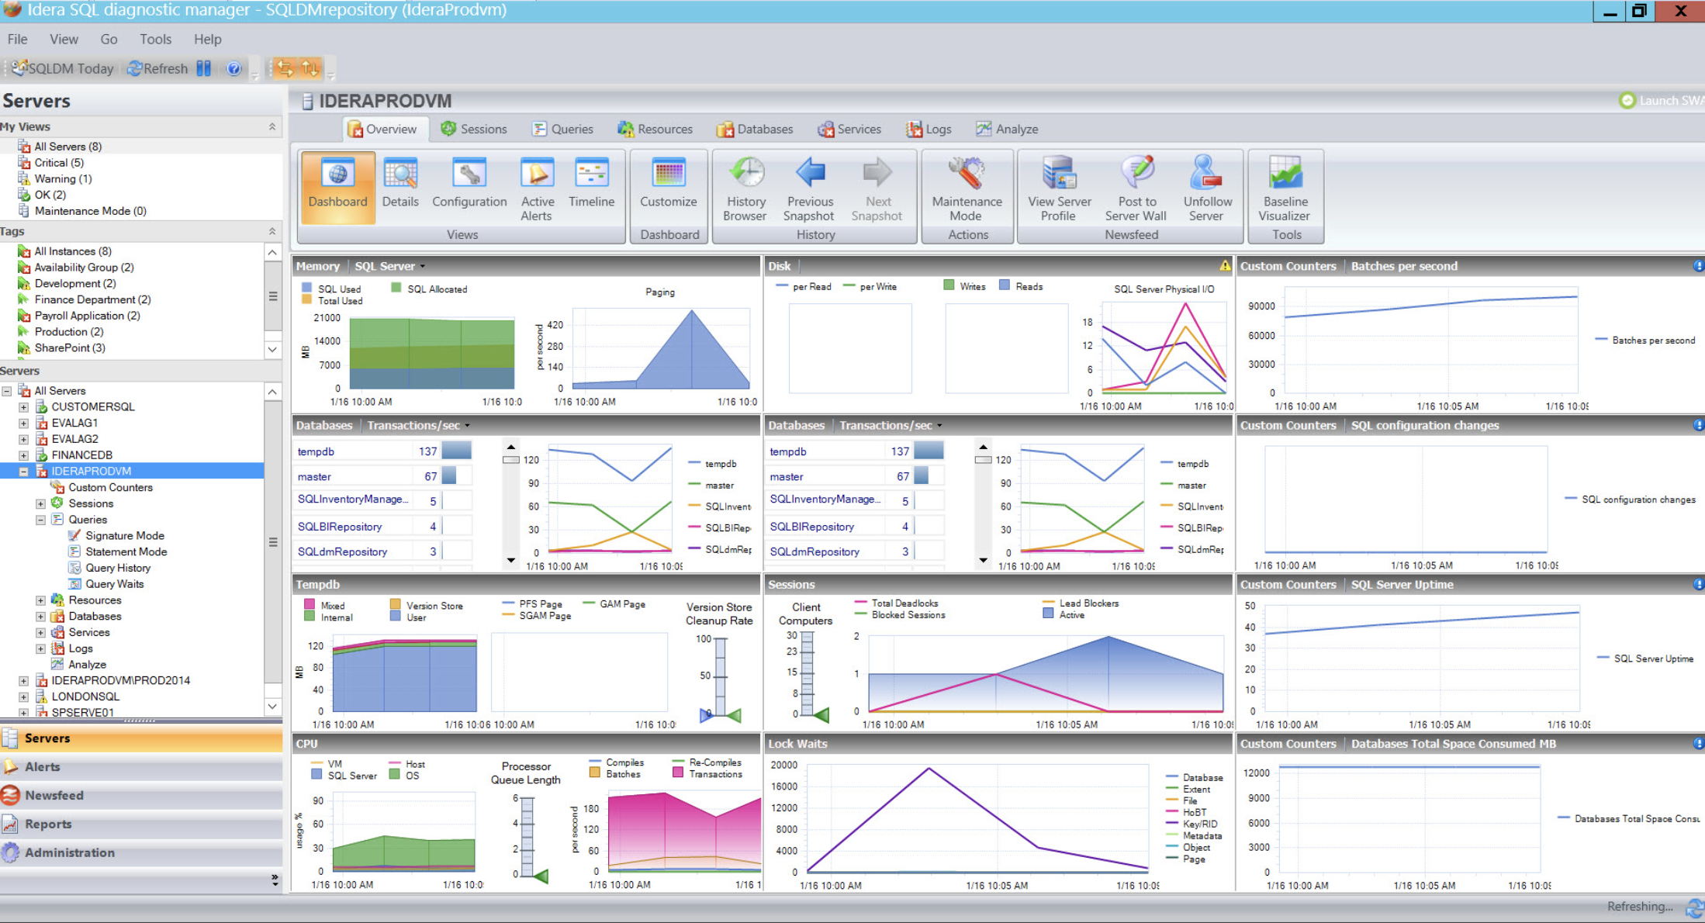
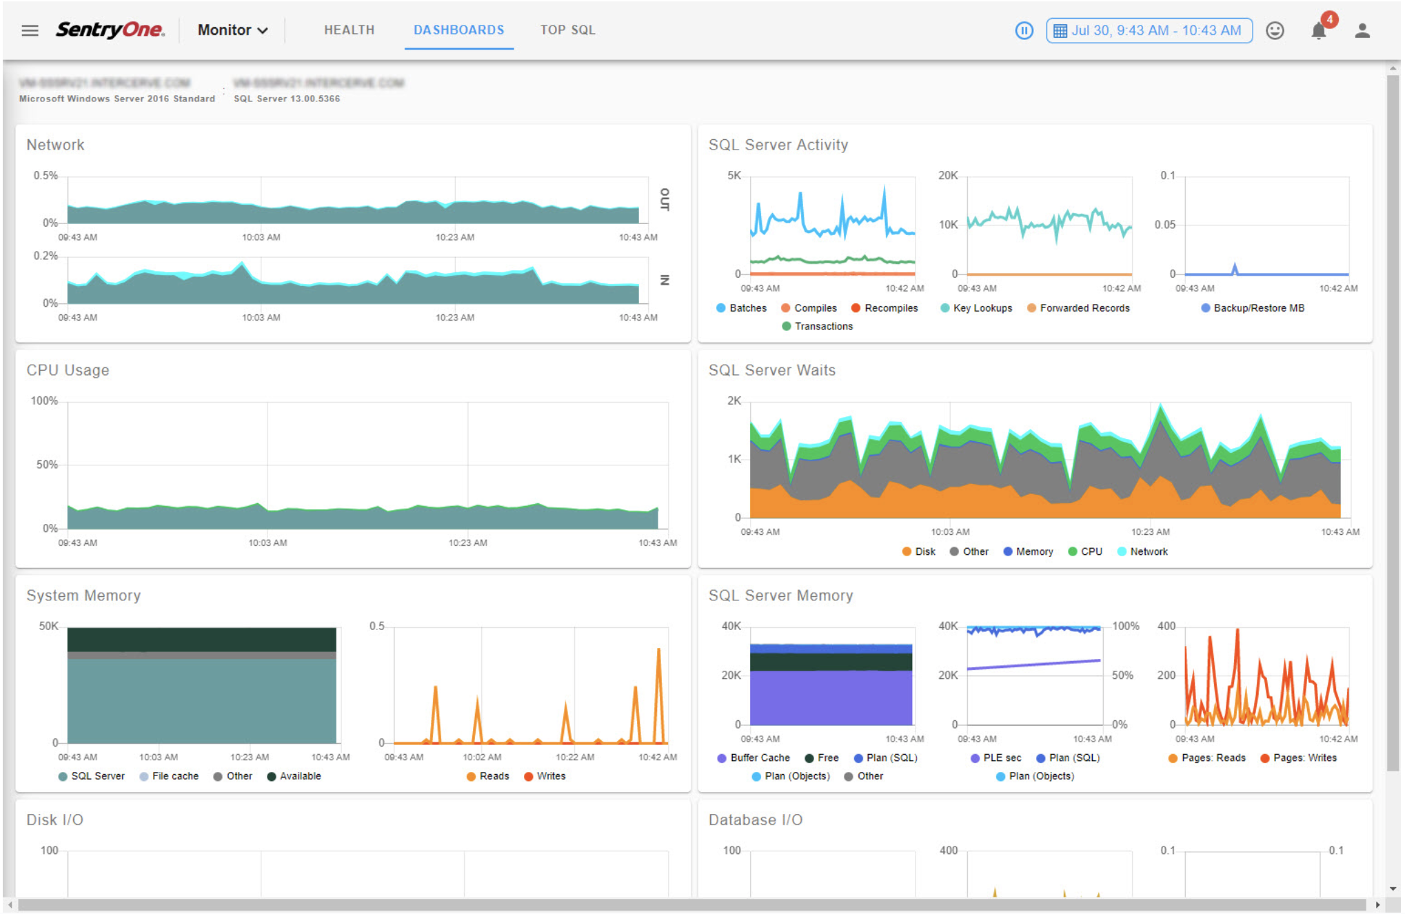
Build or Buy ?

Slide 7
Build: what’s available?
Built-in tools
Dynamic Management Views
SQL Trace
Extended Events
Perfmon
Windows Event logs
Hypervisor metrics
Cloud provider metrics

Slide 8
Build: what to expect
If you choose to monitor by yourself you need to:
Collect and aggregate relevant and actionable metrics
Understand your data platform (including virtualization and cloud)
Analyze current and historical database performance
Generate alerts on important events
Scale the monitoring environment together with the data platform
Maintain a low footprint to avoid the «observer overhead»

Slide 9
My solution
InfluxDB
Telegraf
Grafana

Slide 10
InfluxDB
Open source time series database
  https://github.com/influxdata/influxdb
Written in Go
No external dependency
Schemaless
Client libraries available for developers
Storing large amounts of data providing fast query results
There is a version 2.0 but still in beta while presenting this session

Slide 11
Telegraf
Agent for collecting, processing, aggregating, and writing metrics
  https://github.com/influxdata/telegraf
Written in Go
Lots of plugins
  Input, output, aggregator, processor
Super easy to install and configure

Slide 12


Slide 13
Grafana
Open source Javascript Dashboard
Rich graphing features
Rich time series query features
Templated queries
Annotations
Dashboard search
Dashboard playlists
Dashboard Export / Import

Slide 14
Grafana
Rich graphing features
Multiple y-axis
Y-axis unit formats (ms, percent, Gigabytes, etc)
Bars, lines, points (can be mixed in the same graph)
Grid options
Visual thresholds
Legend values and placement options
Zoom

Slide 15

Installing & configuring the stack

Slide 16
Install InfluxDB
https://portal.influxdata.com/downloads/
Available for
  Docker
  Ubuntu & Debian
  RedHat & CentOS
  Mac OS X
  Windows
  Other linux

Slide 17
Install InfluxDB on CentOS
# wget https://dl.influxdata.com/influxdb/releases/influxdb-1.7.10.x86_64.rpm
# sudo yum localinstall influxdb-1.7.10.x86_64.rpm
# sudo systemctl start influxdb && sudo systemctl enable influxdb
# sudo firewall-cmd --add-port=8086/tcp --permanent
# sudo firewall-cmd --reload
# sudo firewall-cmd –state
# sudo firewall-cmd --list-all

Slide 18
Create a database to store time series data
# influx
Connected to http://localhost:8086 version 1.7.10
InfluxDB shell version 1.7.10
> CREATE DATABASE telegraf
> CREATE RETENTION POLICY telegraf_30d ON telegraf DURATION 30d
REPLICATION 1 DEFAULT
> SHOW DATABASES
> CREATE USER username WITH PASSWORD 'password' WITH ALL PRIVILEGES;

Slide 19
Configure InfluxDB
# vi /etc/influxdb/influxdb.conf
Change the following options in the [http] section:
[http]
enabled = true
flux-enabled = true
bind-address = ":8086"
auth-enabled = true
log-enabled = true

Slide 20
Check InfluxDB connectivity
# sudo systemctl stop influxdb
# sudo systemctl start influxdb
# curl -G http://localhost:8086/query -u username:password --data-urlencode "q=SHOW DATABASES"

Slide 21
Telegraf installation & configuration

Slide 22
Configure a new user for Telegraf on SQL Server
Login on SQL Server to monitor with a privileged user and create telegraf user:
CREATE LOGIN telegraf WITH PASSWORD='Tel3Gr@f!'
GO
GRANT VIEW SERVER STATE TO [telegraf];
GO
GRANT VIEW ANY DEFINITION TO [telegraf];
GO

Slide 23
Install Telegraf on Windows/SQL Server
Download the following file (from SQL Server to monitor – Windows OS):
https://dl.influxdata.com/telegraf/releases/telegraf-1.14.0_windows_amd64.zip
Extract the zip file to the folder C:\Program Files\Telegraf
Change Telegraf configuration by modifying the file telegraf.conf

Slide 24

Configure telegraf.conf
[[outputs.influxdb]]
urls = ["http://your-influxdb-ip-address:8086"]
database = "telegraf»
retention_policy = "telegraf_30d"
username = "username"
password = "password"

Slide 25
Configure telegraf.conf
[[inputs.win_perf_counters]]
[[inputs.win_perf_counters.object]]
ObjectName = "Processor"
Instances = ["*"]
Counters = [
"% Idle Time", "% Interrupt Time", "% Privileged Time", "% User Time",
"% Processor Time", "% DPC Time",
]
Measurement = "win_cpu"
IncludeTotal=true

Slide 26
Configure telegraf.conf
[[inputs.sqlserver]]
servers = [
"Server=localhost;Port=1433;User Id=telegraf;Password=Tel3Gr@f!;app name=telegraf;log=1;",
]
query_version = 2
## If you are using AzureDB, setting this to True will gather resource utilization metrics
# azuredb = False
## If you would like to exclude some of the metrics queries, list them here
# exclude_query = [ 'PerformanceCounters','WaitStatsCatagorized' ]

Slide 27
Install Telegraf on Windows/SQL Server
Install Telegraf as a Windows service:
"C:\Program Files\Telegraf\telegraf.exe" --service install --config "C:\Program Files\Telegraf\telegraf.conf"
Windows + R, run services.msc, start Telegraf service

Slide 28
Grafana installation

Slide 29
Install Grafana on CentOS
# wget https://dl.grafana.com/oss/release/grafana-6.7.2-1.x86_64.rpm
# sudo yum localinstall grafana-6.7.2-1.x86_64.rpm
# sudo firewall-cmd --add-port=3000/tcp --permanent
# sudo firewall-cmd --reload

Slide 30
DEMO

Slide 31
Ideas

Slide 32
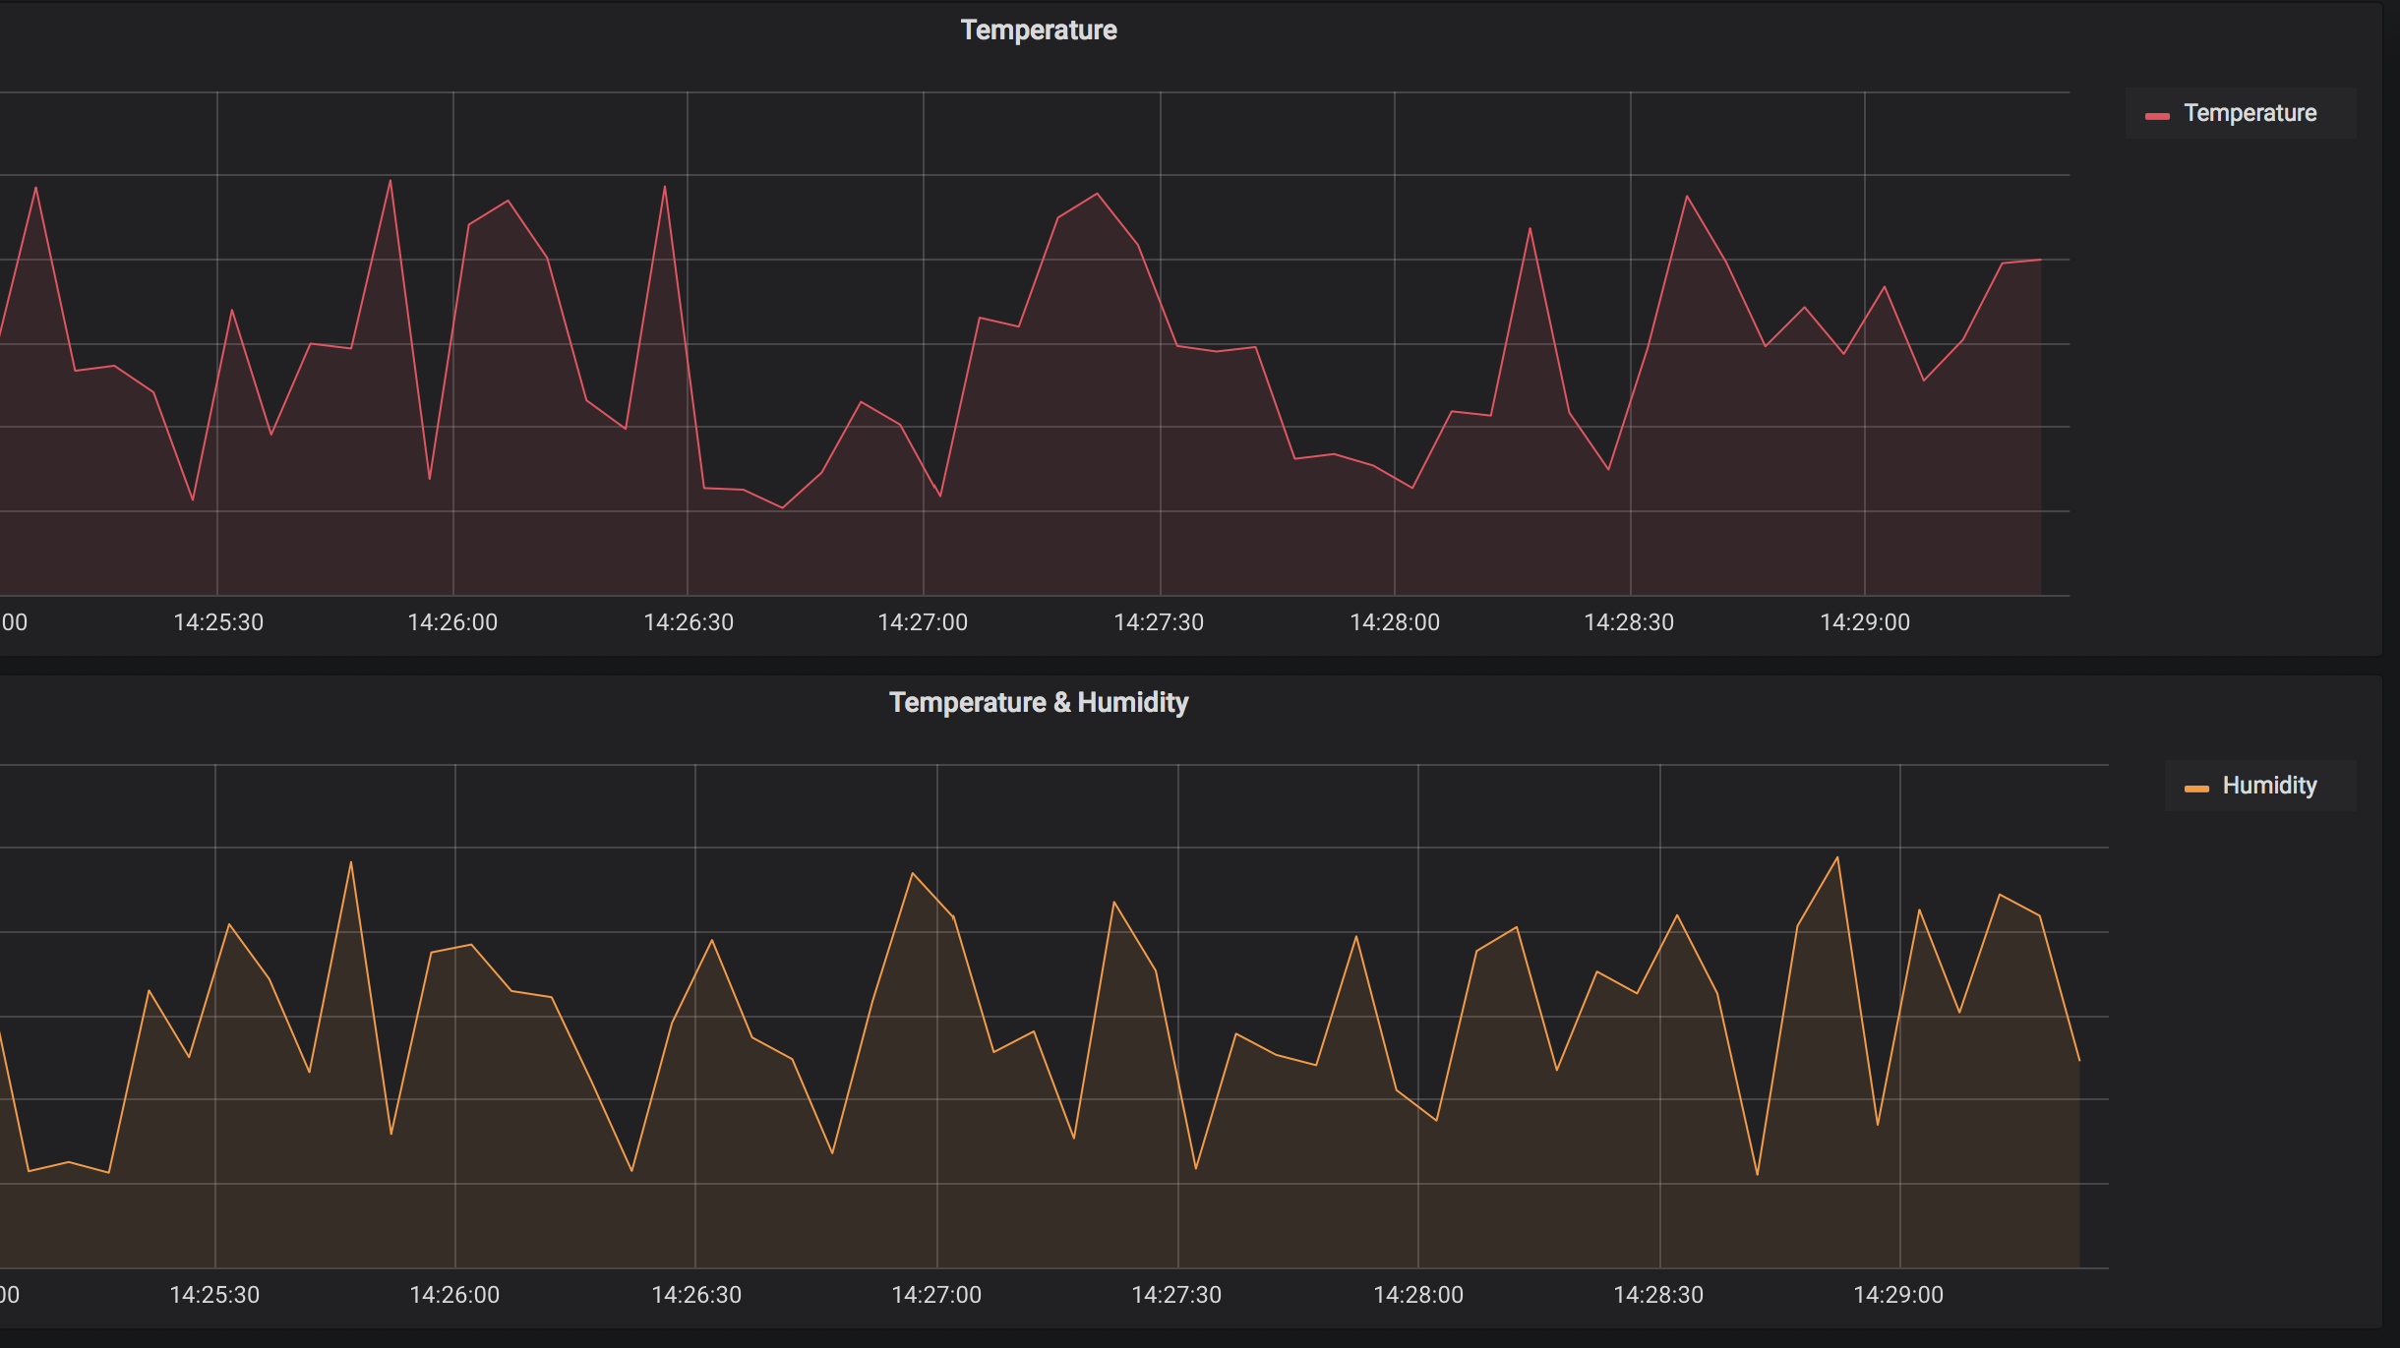
Bonus: monitor your data center temp & humidity
InfluxDB exposes API to read/write data
You can program an Arduino or a NodeMCU to send JSON data to InfluxDB by calling its APIs

Slide 33
Example: Load random data to InfluxDB via Powershell
# Install Influx Powershell Module by running: Install-Module Influx -Scope CurrentUser
Import-Module Influx
$cred = Get-Credential
While ($true)
{
$t = Get-Random -Minimum 19.0 -Maximum 21.0
$h = Get-Random -Minimum 45.0 -Maximum 55.0
Write-Influx -Measure Ambient `
-Tags @{Hostname=$env:COMPUTERNAME} -Metrics @{Temperature=$t;Humidity=$h} `
-Database telegraf -Server http://192.168.184.228:8086 -Credential $cred -Verbose
Start-Sleep 5
}

Slide 34
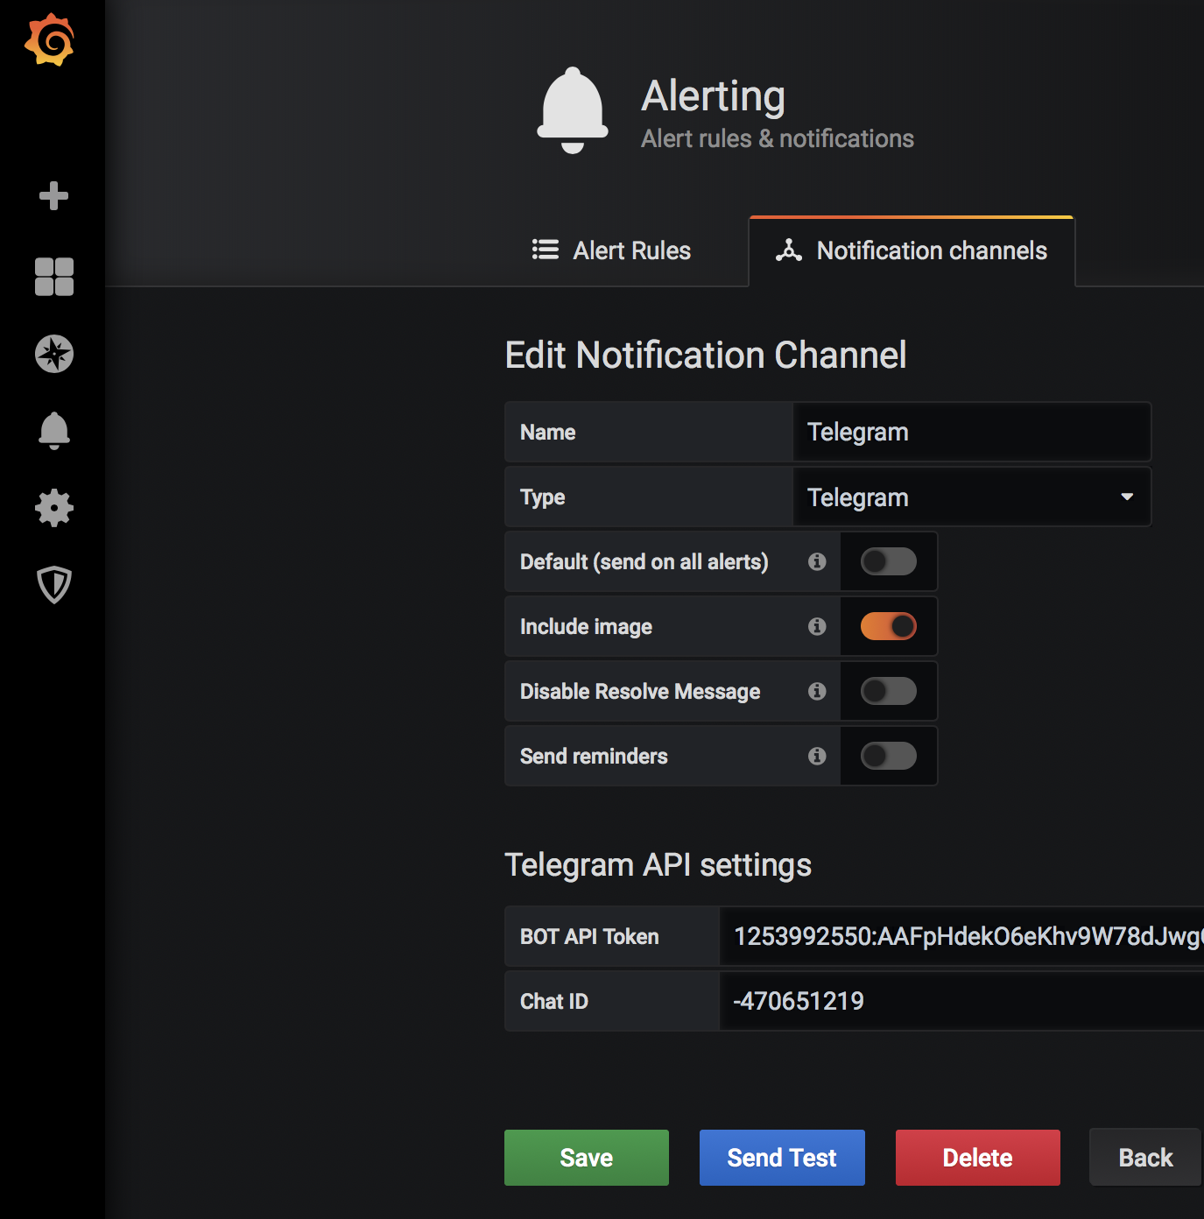
Bonus: configure Telegram notifications
Create a new BOT using @BotFather and get the API token (https://core.telegram.org/bots#3-how-do-i-create-a-bot)
Create a new group from Telegram and add your BOT
Use curl to obtain the chat_id
https://api.telegram.org/bot<TOKEN>/getUpdates
Ex: "chat":{"id":-470651219,"title":"MonitorSql","type":"group»
Fill the Telegram API Settings in the Alerting Notification section
with both the API token and chat ID

Slide 35
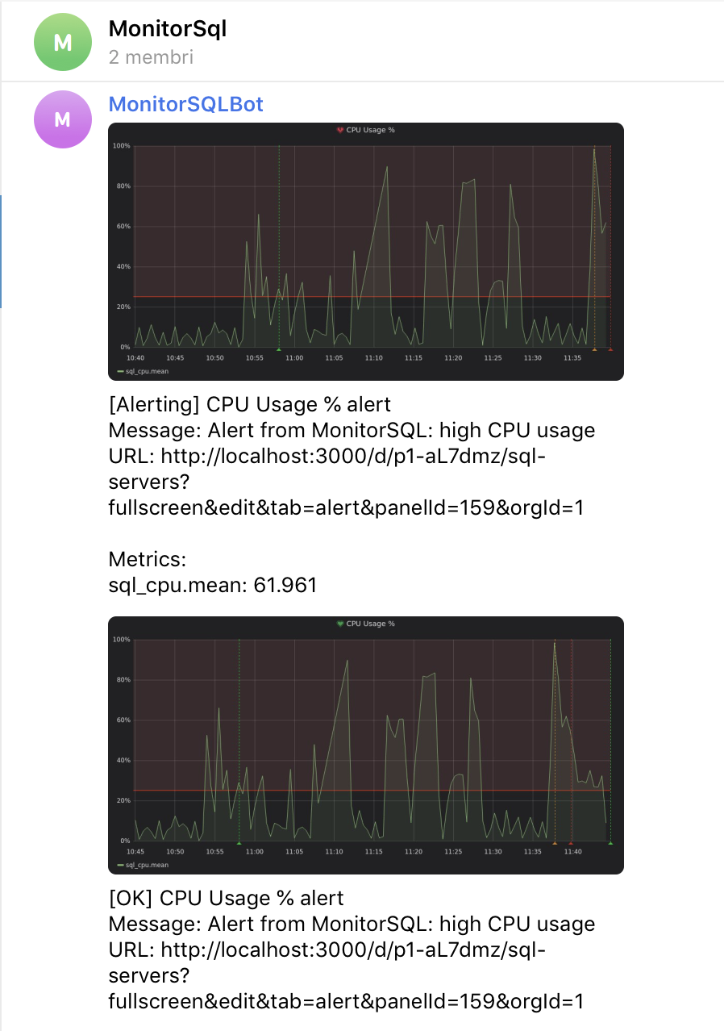
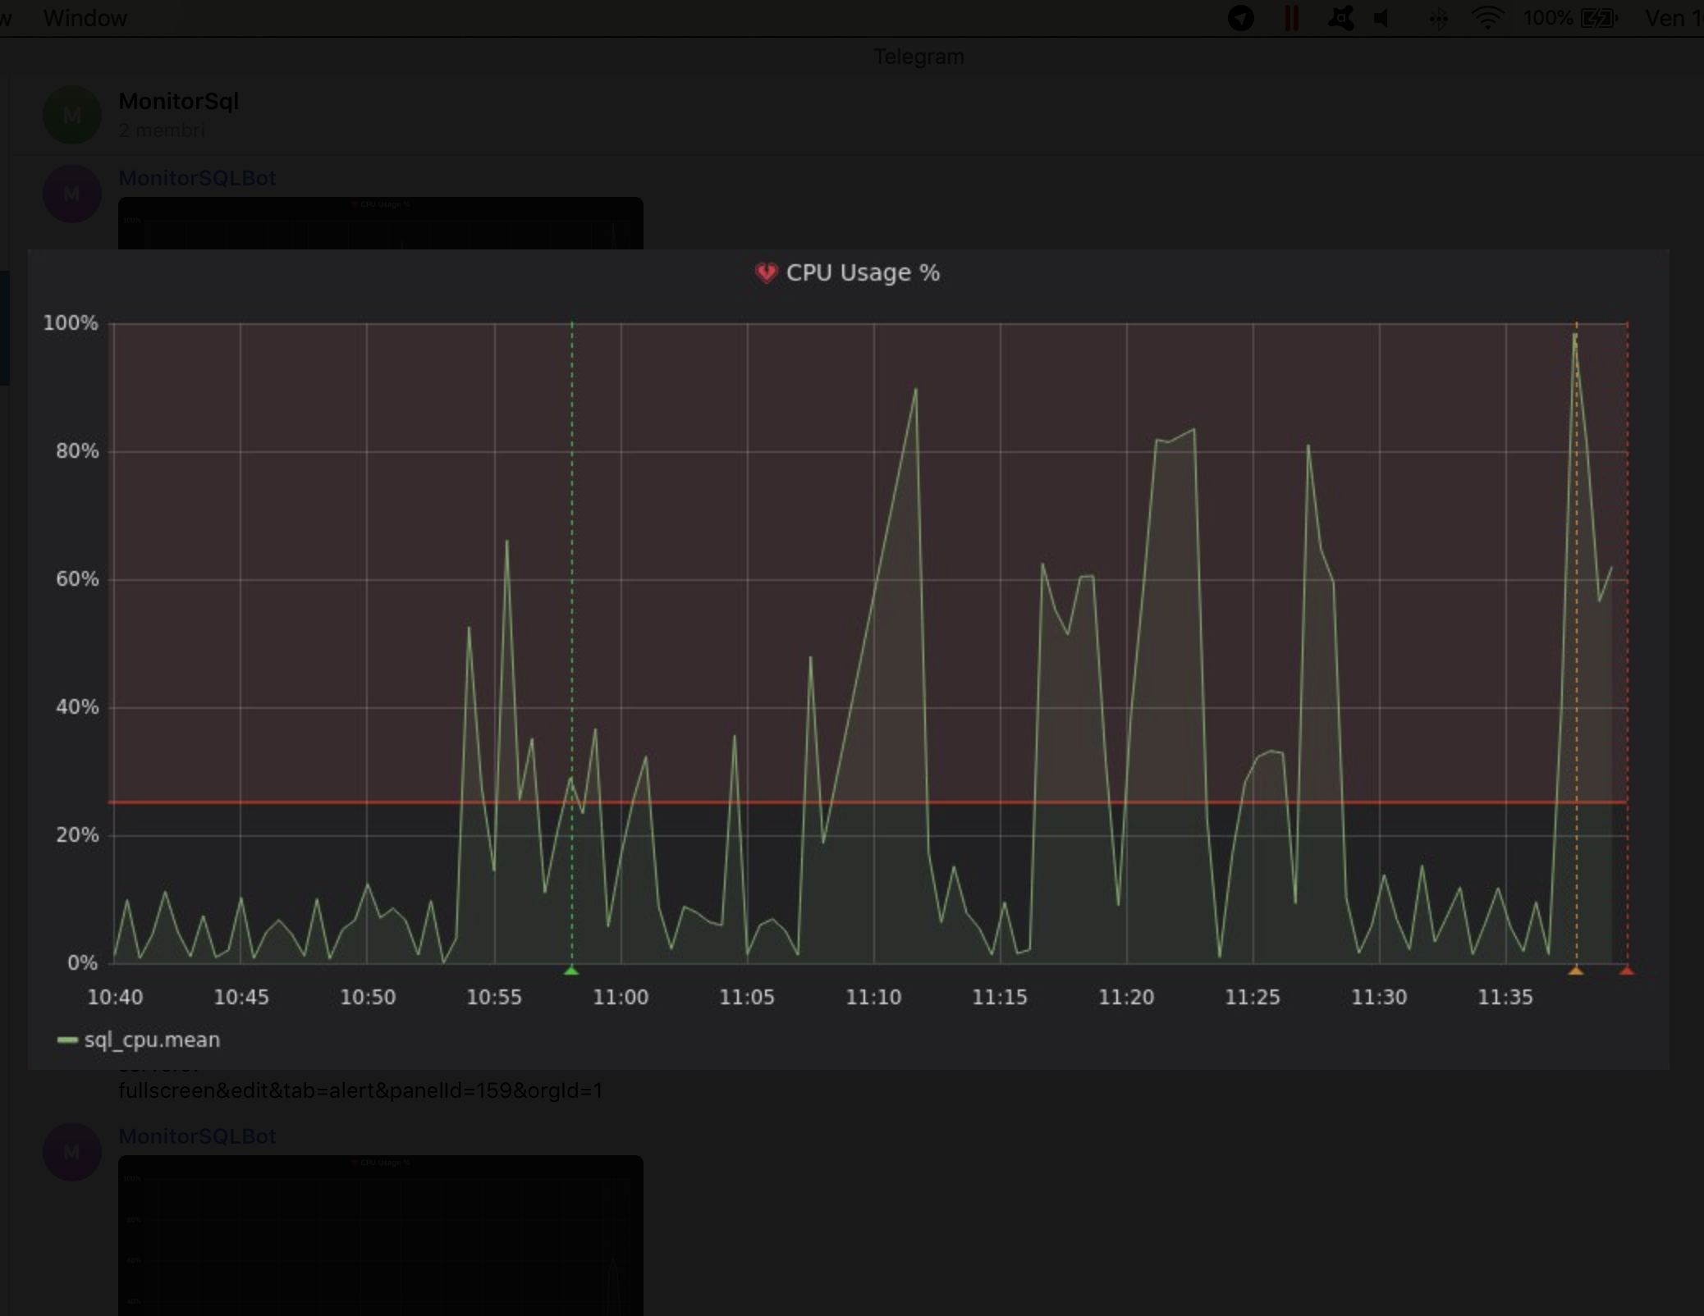

Slide 36
Resources
https://portal.influxdata.com/downloads/
https://docs.influxdata.com/influxdb/v1.7/
https://docs.influxdata.com/telegraf/v1.14/
https://grafana.com/grafana/download
https://tracyboggiano.com/archive/2018/02/setup-of-telegraf/
https://www.petersplanet.nl/index.php/2018/11/18/basic-installation-of-grafana-influxdb-and-telegraf-on-centos-7/
https://github.com/markwragg/PowerShell-Influx

